Slide 1
MAR 580: Models for Marine Ecosystem Based Management
Lecture 1
Course Introduction & Review of Fisheries Models
29 January 2016

Slide 2
Today’s Outline
Introductions
Course Description (syllabus)
Objectives
Readings
Evaluation Procedures
Schedule
Whats and Whys of EBM
Review of Fisheries Assessment Models

Slide 3
Instructor contact information
Gavin Fay
gfay@umassd.edu
508-910-6363
SMAST II Rm 325B
@gavin_fay
Office hours: by appointment

Slide 4
Course Description
Instruction, demonstration, and exercises in quantitative modeling tools used for Ecosystem Based Management (EBM) of living marine resources.
Apply fisheries stock assessment and population models that include ecosystem effects, and consider the policy implications of including this information.
Multiple-use and human dimensions models including models for marine spatial planning.
Whole-of-ecosystem models and how these can be used to provide strategic advice for marine management and consider a broad suite of objectives.
Objectives
Familiarity with a range of models used for ecosystem-based management and experience using some of them.
Understanding of the benefits, challenges, and limitations of using these models to provide scientific advice for management.

Slide 5


Readings
No required text.
Recommended papers distributed with lecture notes.
Useful books:

Slide 6
Evaluation procedure
Five Homework Assignments (12% each)
Final Project (40%)
Apply one/some of the modeling methods covered during the course to a research-related task.
2-page outline due Feb 19th (5%)
Brief meeting with GF to discuss outline
Final paper in form of draft manuscript (25%)
Verbal presentation (final exam) (10%)
University Academic Integrity policy applies: http://www.umassd.edu/studentaffairs/studenthandbook/academicregulationsandprocedures/

Slide 7
Class Schedule
Fridays 10:30 – 13:00
Each week:
1. Informal lecture
2. Break
3. Hands-on Computer Lab

Slide 8
Simplified Schedule
Week | Topic | Assignments
1/29 | Intro to EBM, review of fisheries assessment models
2/5 | Stock assessment models with ecosystem processes
2/12 | Multispecies models, estimating species interactions | HWK 1 due
2/19 | Guest lecture: Food web models I (Ecopath) | Project outlines
2/26 | Guest lecture: Food web models II (Ecosim) | HWK 2 due
3 / 4 | MICE Models, Multispecies policy advice
3/11 | Marine spatial planning models, marine reserve design | HWK 3 due
3/18 | SPRING BREAK
3/25 | No Class - IMS Research Symposium (several mini-lectures)
4/1 | Valuation of ecosystem services | HWK 4 due
4/8 | No Class – Stock Synthesis training course
4/15 | Whole of system models, MSE for ecosystems
4/22 | Qualitative modeling, model structure uncertainty | HWK 5 due
4/29 | Participatory modeling, multicriteria decision analysis
5/6 | Final exam: Project Presentations | Final papers

Slide 9
Whats and Whys of Ecosystem Based Management

Slide 10
EBM Definitions
“Ecosystem based management is an integrated approach to management that considers the entire ecosystem, including humans. The goal of EBM is to maintain an ecosystem in a healthy, productive and resilient condition so that it can provide the services humans want and need. EBM differs from current approaches that usually focus on a single species, sector, activity or concern; it considers the cumulative impacts of different sectors”
(McLeod et al. 2005)

Slide 11
EBM Definitions
“U.S. ocean and coastal resources should be managed to reflect the relationships among all ecosystem components, including human and nonhuman species and the environments in which they live. Applying this principle will require defining relevant geographic management areas based on ecosystem, rather than political, boundaries.”
U.S. Commission on Ocean Policy

Slide 12
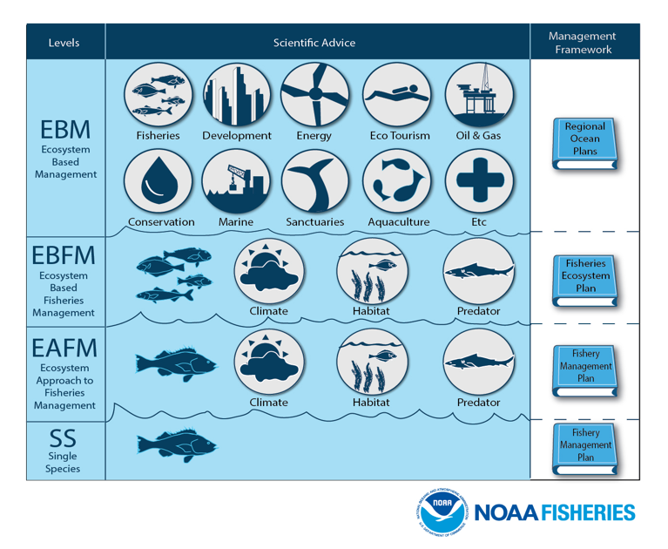

Slide 13
Key elements in EBM definitions
Connections
between marine ecosystems and social systems
Cumulative Impacts
Effects of multiple activities on ecosystem services
Multiple Objectives
Range of benefits we receive from marine systems, rather than a single service.
Ability to embrace change
Resilience science
Multiple possible states, abrupt changes
Adaptive management

Slide 14
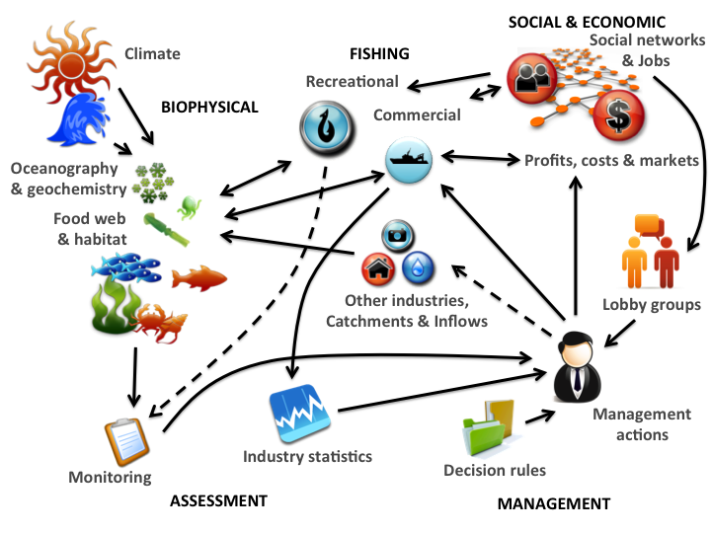
Coupled social-ecological systems

Slide 15
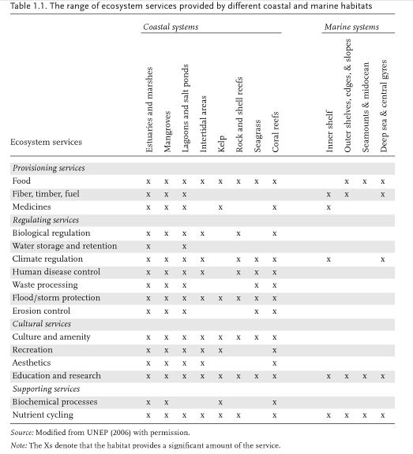
Ecosystem Services
Broader suite than under fisheries management.

Slide 16
What does an Ecosystem Approach provide that we can’t get from single-species?
Address effects of fishing on:
non-target species
habitat,
ecological interactions, and
system-wide processes
Recognizes that marine ecosystems provide “goods & services” other than fishery harvest
Explicitly addresses biomass tradeoffs
Increases leverage from new stakeholders
Changes the burden of proof

Slide 17
Origins and history of EBFM
Thomas Huxley (1883)
“all the great sea-fisheries are inexhaustible; that is to say nothing we can do seriously affects the number of fish.”

Slide 18


Key literary foundations to EBM
Leopold 1949 “Sand County Almanac”
Carson 1962 “Silent Spring”
Holling 1978 “Resilience and Stability of Ecological Systems”
Walters 1986 “Adaptive Management”

Slide 19
Where did EBM and related approaches more recently and formally come from?
International recognition in the 1970s, 1980s, to early 1990s that the earth’s ecosystems were being/had been seriously impacted by human use.
to the point that future human development, economic benefits and well-being would be threatened.
Creation of the sustainable development agenda, related international agreements, and in some cases national enabling arrangements
For individual uses / industry sectors as well as the cumulative impact of all uses in regional ecosystems.
Sainsbury 2004

Slide 20
Origins and history of EBM
Stockholm Conference on Human Development (1972)
Convention on International Trade in Endangered Species (1973)
Bonn Convention on Migratory Species of Wild Animals (1979)
UN Convention on the Law of the Sea (1982)
World Commission on Environment and Development (1987)

Slide 21
Origins and history of EBM/EBFM
UN Convention on Environment and Development (1992)
clearly established the Sustainable Development agenda.
Convention on Biological Diversity (1992)
Jakarta Mandate (1995)
FAO Code of Conduct for Responsible Fisheries (1995)
Reykjavik Conference (2001)
World Summit on Sustainable Development (2002)

Slide 22
Example Efforts at Defining EBM
Marine
Larkin 1996
Botsford et al. 1997
EPAP 1999
Link 2002
Pikitch 2004
USCOP 2004
POC 2004
Browman & Stergiou 2004
General/Terrestrial
Slocombe 1993
Grumbine 1994, 1997
Haueber 1996
Christensen et al. 1996
Yaffee et al. 1996
Franklin 1997
Boyce & Haney 1997
Lackey 1998

Slide 23
Why a course on models for EBM?

Slide 24
Kinds of Management advice
There are generally 3 levels of advice in a natural resource management context.
Heuristic
Strategic
Tactical

Slide 25
Heurism
Understanding ecosystem functioning
Relative importance of different processes
Advancing scientific theory

Slide 26
Strategic management
Assessing biomass tradeoffs
System level emergent properties
Evaluating major processes
Alternate stable states
Long term recruitment bottlenecks
General “What If” scenarios and gaming, long term trends
What needs to be done
BOUNDING IN SCOPE

Slide 27
Tactical management
Revised stock assessments
Yield adjustments
Biological reference points, etc.
Direct impacts on target, non-target species, protected species, habitat, aggregate groups
Specific “What If” scenarios and gaming
How to do what needs to be done.
BINDING IN SCOPE

Slide 28
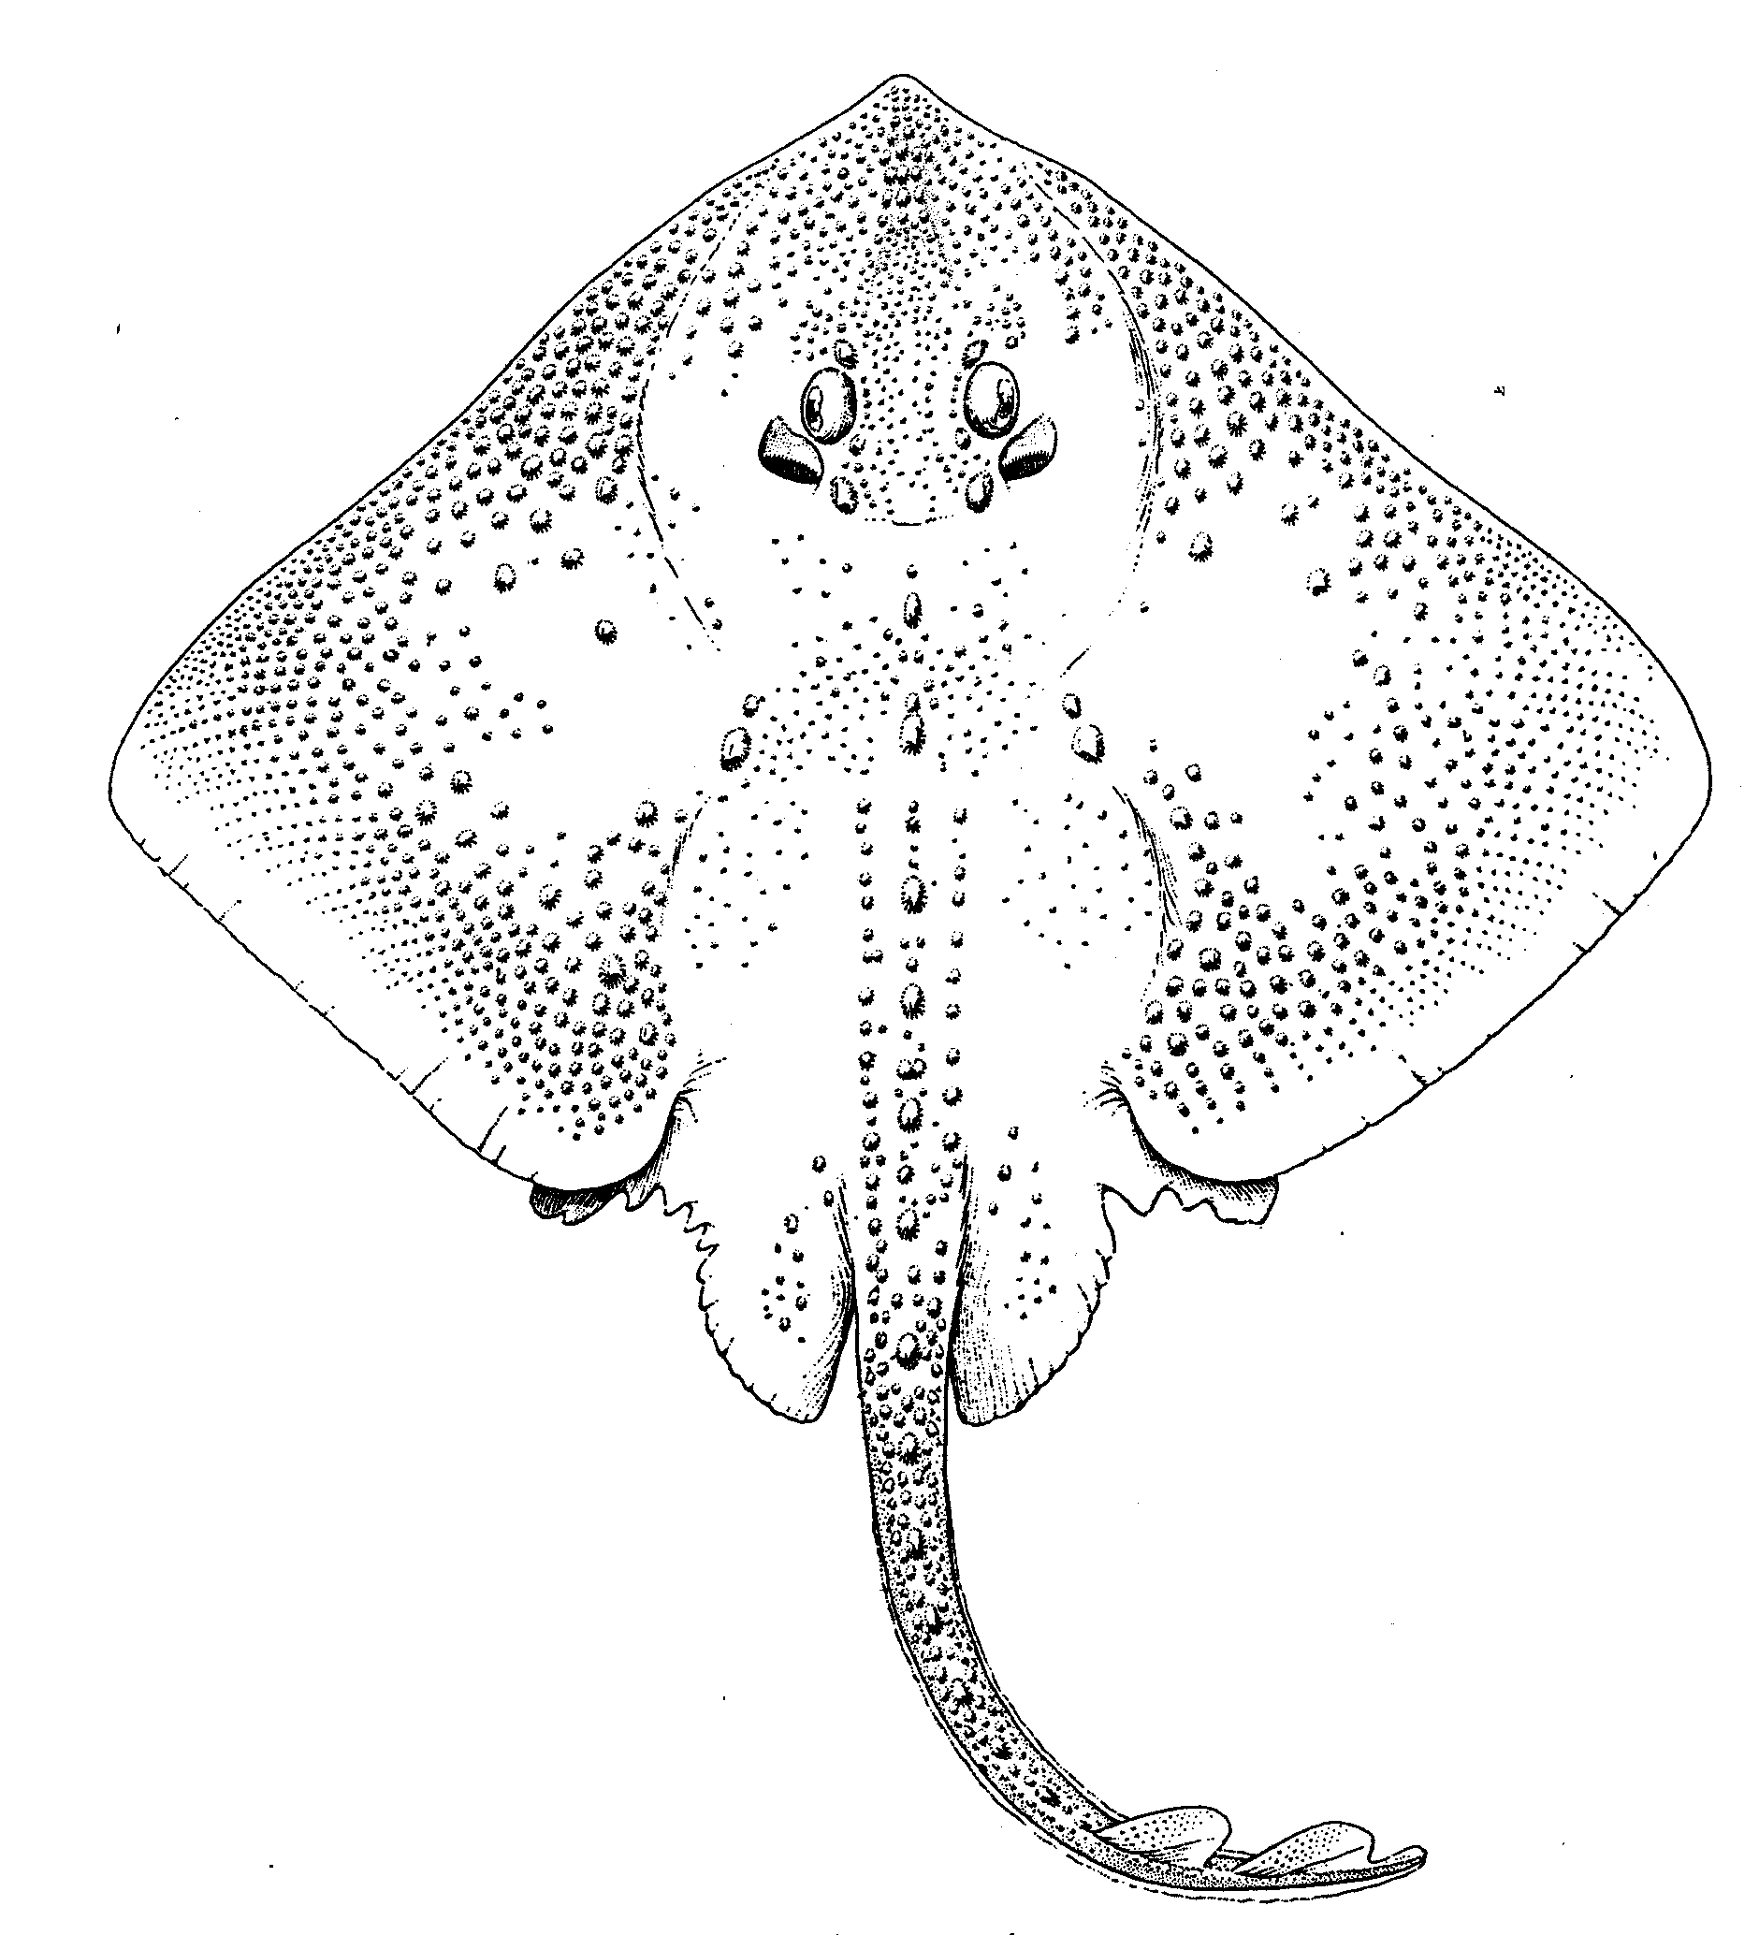
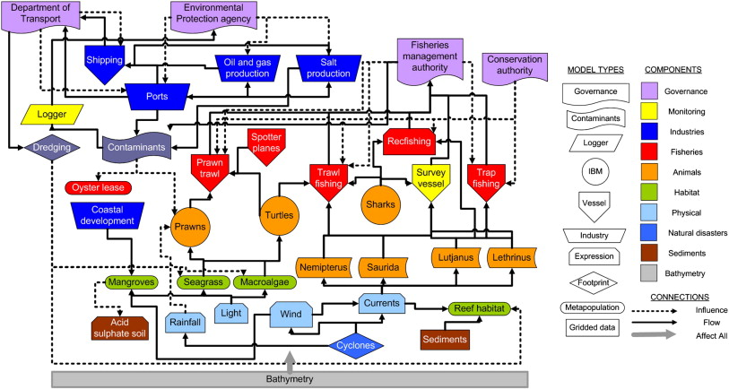
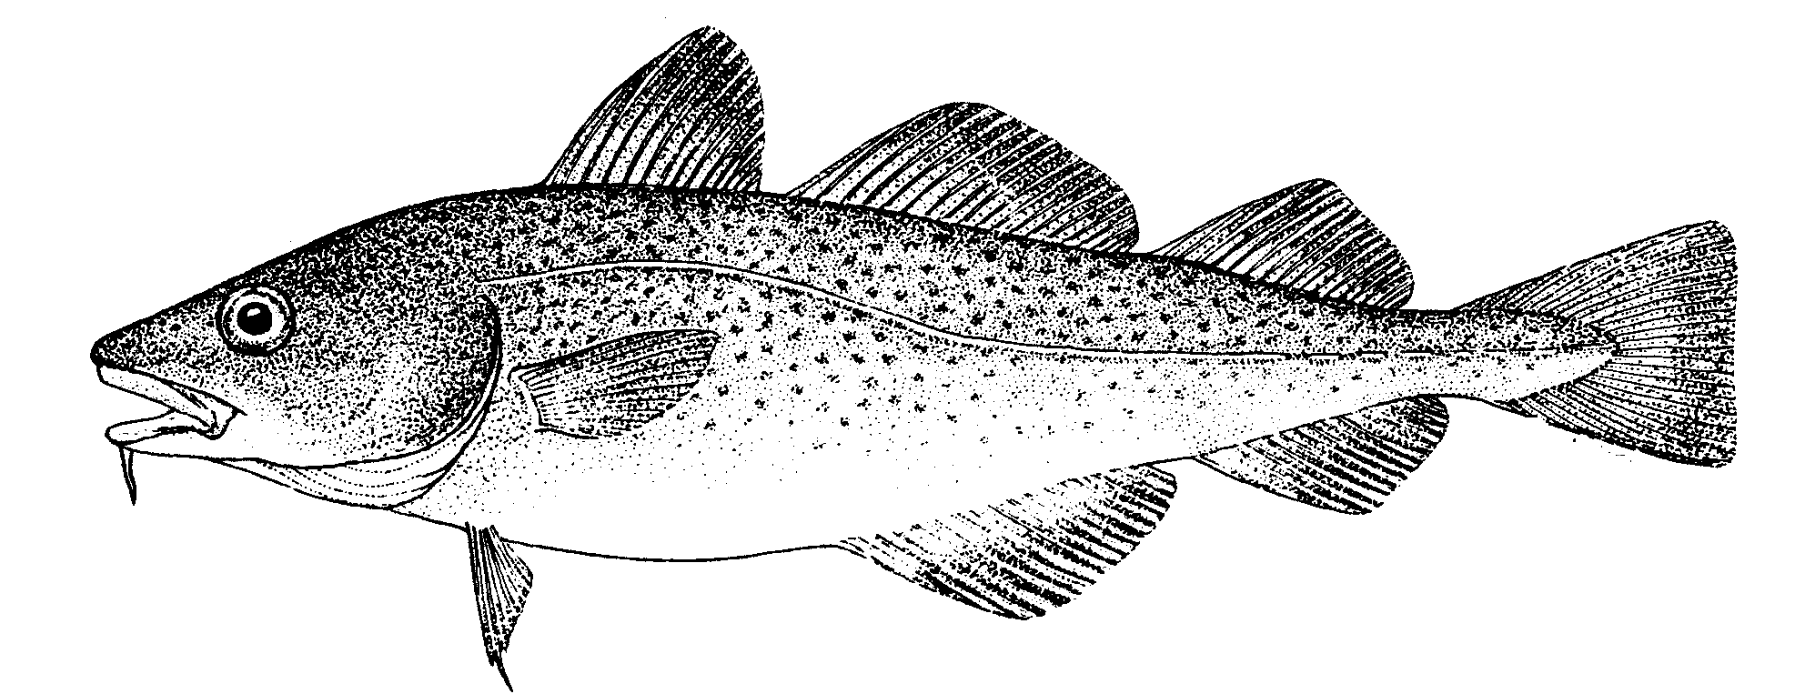
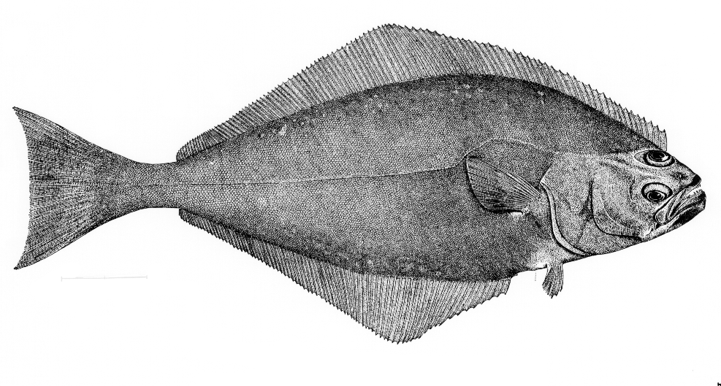
Appropriate tool might depend on level of advice required
Can Control & Measure Fishing Effort
Realism
Parsimony
Addresses Ecosystem Issues
Existing Methods and Metrics
Data Requirements (=Cost)
Stock/Single Species
Multi-species
Aggregate Biomass
Ecosystem
Messy Picture Here
Gadids
Pelagics
Flatfish
Predation, Competition, Mutualism, etc.
Habitat, Climate, etc.
Disease, Genetic Diversity, Fecundity, Migration, etc.
Technical Interactions

Slide 29



Link’s Three Pillars of EBM
1. Goal Setting (Priorities & Allocation of Biomass)
2. Assessing [Ecosystem] Status (Multivariate metrics)
3. Achieving [Ecosystem] Goals (Management Tools)
Models used here

Slide 30
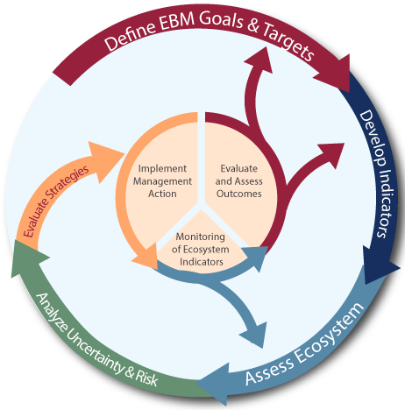
NOAA Fisheries IEA program

Slide 31
Dealing with Tradeoffs
Some tradeoffs may be easier than others.
Gain on one, lose on the other.
Don’t have to give up much to gain.
Objective 2
Strong tradeoff, not able to gain on one without giving up a lot on the other.
Objective 1

Slide 32
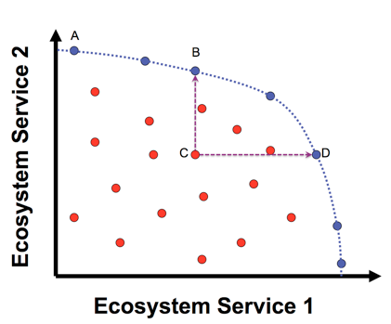
Evaluating Trade-offs
View performance of management strategies against multiple objectives or system traits.
A, B, and D are management options that are optimal solutions for one objective given a value for the other.
Management options in red are sub-optimal for both objectives.

Slide 33
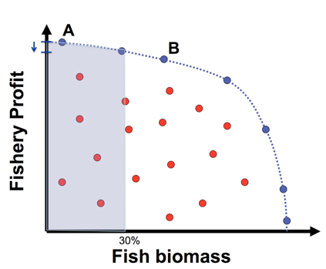
Evaluating Trade-offs
Operational objectives may indicate nonviable options (e.g. minimum stock size thresholds).
Can quantify effects of alternatives.
Here very little loss in profit from A to B is associated with large gain in biomass.

Slide 34
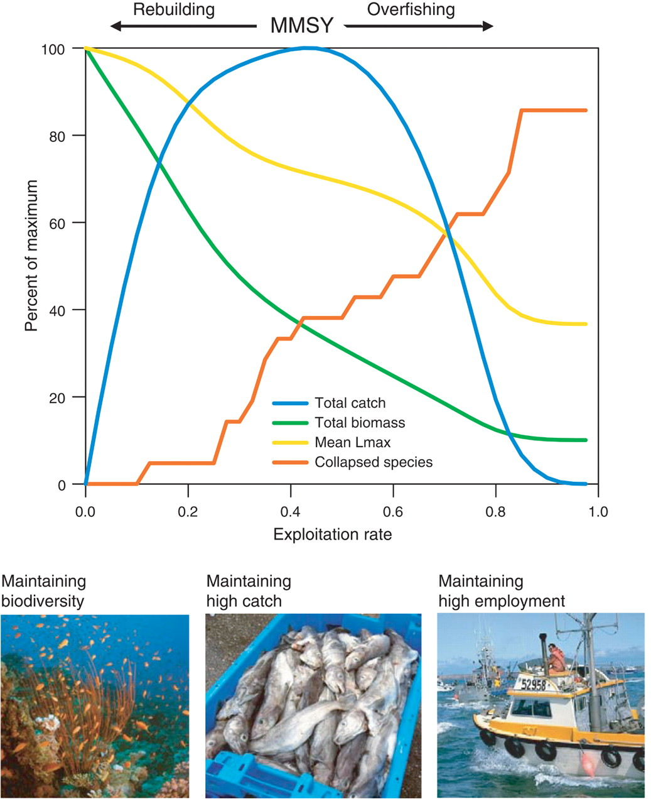
Worm et al. (2009)
Ecosystem models to
quantify tradeoffs between biodiversity, catch, and employment.
Able to gain biodiversity with small loss in fishery yield.

Slide 35
Outstanding research questions for marine EBM
What can we learn from how humans have interacted with coastal and marine environments in the past?
How do we translate knowledge developed at the local scale to broader geographic scales?
What are the cumulative impacts of human activities on ecosystem health and human well-being?
How can trade-offs among ecosystem services and sectors be more systematically assessed?
How do we evaluate the success of ecosystem-based management efforts?
(McLeod & Leslie 2009)

Slide 36
Outstanding research questions for marine EBM
What can we learn from how humans have interacted with coastal and marine environments in the past?
How do we translate knowledge developed at the local scale to broader geographic scales?
What are the cumulative impacts of human activities on ecosystem health and human well-being?
How can trade-offs among ecosystem services and sectors be more systematically assessed?
How do we evaluate the success of ecosystem-based management efforts?
(McLeod & Leslie 2009)

Slide 37
What is EBM?
Questions?

Slide 38
BREAK

Slide 39
Fisheries models review

Slide 40
Use of models in fisheries and conservation
How many of animal X are there?
Estimating extinction risk.
How many can we harvest?
System relationships and dynamics
How well are hypotheses supported by data?
Designing management programs

Slide 41
(almost) all you ever need to know for Population Modeling
Numbers next year = numbers this year
+ births – deaths + immigrants – emigrants

Slide 42
Single Species Models
Index-based methods
Equilibrium & Generation methods
Yield-Per-Recruit / Stock-Recruitment
Population dynamics models
Biomass aggregated models
e.g. production models
Stage-Structured models
Delay difference models
Age structured models
virtual population analysis, statistical catch-at-age
Size-based models

Slide 43
Single Species Models
Index-based methods
Equilibrium & Generation methods
Yield-Per-Recruit / Stock-Recruitment
Population dynamics models
Biomass aggregated models
e.g. production models
Stage-Structured models
Delay difference models
Age structured models
virtual population analysis, statistical catch-at-age
Size-based models

Slide 44
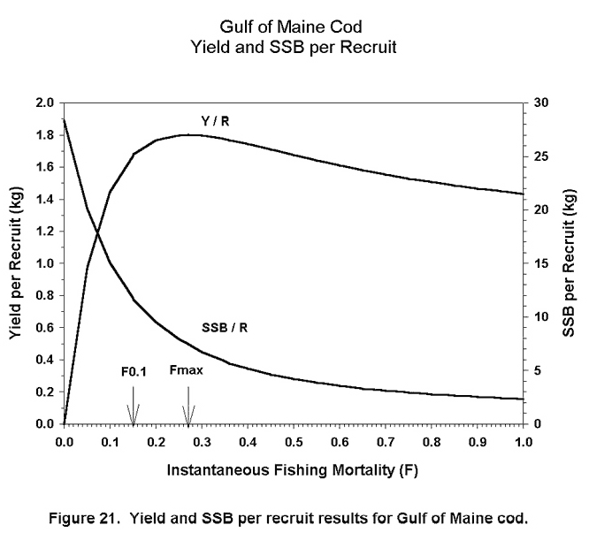
Yield per Recruit
Balance mortality with growth
Implications of fishing intensities/selectivities.
Constant recruitment
Mayo, R.K.; Thunberg, E.M.; Wigley, S.E; Cadrin, S.X. 2002. The 2001 assessment of the Gulf of Maine Atlantic cod stock. Northeast Fish. Sci. Cent. Ref. Doc. 02-02; 154 p.

Slide 45
Yield per-recruit analysis
Classical discrete type, age structured model
Assumes constant recruitment
but can be linked to spawner-recruit relationships
Not dynamic

Slide 46
Spawner-Recruit Relationships
Used to predict recruitment as a function of mature stock size.
Density dependence in Recruits per Spawner
Beverton-Holt:
Ricker:

Slide 47
Single Species Models
Index-based methods
Equilibrium & Generation methods
Yield-Per-Recruit / Stock-Recruitment
Population dynamics models
Biomass aggregated models
e.g. production models
Stage-Structured models
Delay difference models
Age structured models
virtual population analysis, statistical catch-at-age
Size-based models

Slide 48
Biomass dynamic (surplus production) models
Surplus production models are commonly defined by equations such as:
where B_{t} is the biomass at the start of year t, f(B_{t}) is the biomass-dynamic as a function of biomass and C_{t} is the catch in weight during year t.
Typical model formulations: Pella Tomlinson, Gompertz-Fox, Graham-Schaefer.
In the absence of fishing, rate of population change is assumed to be a function of the current population size only:
where r = intrinsic rate of population growth, and K = carrying capacity.

Slide 49
Graham-Schaefer production model (logistic growth)
Numbers next year are number this year + net production, minus removals
Catch in
time t
Net production
Population size
time t+1
Carrying capacity
Intrinsic (maximum)
rate of increase
Adapted from Branch

Slide 50
Single Species Models
Index-based methods
Equilibrium & Generation methods
Yield-Per-Recruit / Stock-Recruitment
Population dynamics models
Biomass aggregated models
e.g. production models
Stage-Structured models
Delay difference models
Age structured models
virtual population analysis, statistical catch-at-age
Size-based models

Slide 51
Delay difference models
Intermediate option between age-aggregated and full age-structured models.
Based on some key simplifying assumptions that allow age-structured dynamics to be simplified to a single equation involving total biomass or total numbers only.
Do not require much information.
Are useful when a “realistic” model is needed that doesn’t require substantial data / computer memory.
Not used much today because we have the computing resources to implement full age-structured models.

Slide 52
The Deriso-Schnute Delay Difference model
Mass-at-age follows a von Bertalanffy growth curve.
Recruitment and maturity occur at the same time.
Vulnerability is independent of age above the age-at-maturity.
Natural mortality is independent of age above the age-at-maturity.
“Survival” of biomass
Growth
Notes:
Recruitment
- mass-at-recruitment
The original “Deriso” version corresponds to
The virgin (no fishing) equilibrium is given by:

Slide 53
Age-structured Models
Age-structured models are constructed by selecting specific hypotheses for each key population dynamic process:
Growth, fecundity, natural mortality, exploitation, recruitment
Processes can be time-invariant, stochastic, density-dependent or depensatory.
Typical outputs include:
Abundance of various age-classes
Trends in spawning/vulnerable biomass
Trends in fishing mortality
There are many flavors, estimation of model parameters is typically differentiated by backward (e.g. VPA) or forward (e.g. SCAA) estimation methods.

Slide 54
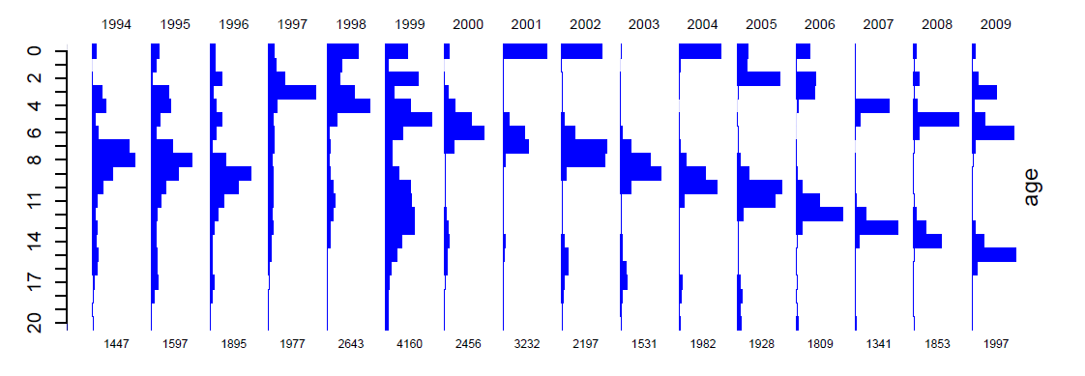
Aim is to use data on the catch-at-age to reconstruct year class size, to give a total population estimate.
Standard VPA works ‘backwards’ over the lifespan of a year-class.
whereas SCAA works ‘forwards’.
Adapted from Cadrin
Klaer et al. 2011. CSIRO.

Slide 55
The basic age-structured model
Spawner-recruit function
Plus-group age

Slide 56
Age-structured models
Advantages:
Populations have age-structure!
More realistic - many processes (birth rate, death rate, growth) are age-specific.
Easily to build in actual processes and highly flexible.
Disadvantages:
Increased complexity.
Data required are not always available.
Age-lumped models often perform as well as age-structured models.
Still not that realistic (no predation, competition, size and spatial structure).

Slide 57
Stage-structured models
Why not always use age-structured models?
Ageing is difficult (or impossible) for several types of organisms.
Division of the population into “stages” may be more natural than into “ages” (the most common type of “stage” is size-class).
Animals in a stage share “demographically similar” characteristics.
The data available to fit the model may be “stage- based” (e.g. the fraction of new-borns, juveniles, mature animals).

Slide 58
Modeling Stage-Structure (differences from age-based models)
The age-based model can be written:
We now generalize this by:
defining each row in N as the abundance of a stage (rather than an age-class);
allowing recruitment to occur to any stage (though usually recruitment only occurs to the first stage); and
allowing animals to move between any stages.

Slide 59
Size-Structured Models
Common for lobsters, crabs, abalone, etc.
For these models, each “stage” is a size-class (usually all of equal width).
The general equation for these models is:

Slide 60
expanded
Natural survival
Harvest survival
Growth
The matrix X is often constrained to prevent “negative growth” (e.g. lobsters, abalone)

Slide 61
Size-structured models
Advantages:
Requires no ability to age animals (crabs, abalone, rock lobsters).
Uses the data actually available (size-compositions).
Vulnerability / maturity are often functions of size and not age.
Disadvantages:
Potentially very many parameters that are difficult to estimate (e.g. the entries in the size-transition matrix).
Still needs an estimate of M (in years⁻¹).
Computationally much more intensive than age-structured models.
Many of the animals to which these models are applied exhibit small-scale spatial differences in growth.

Slide 62
Single species approaches don’t usually (explicitly) consider:
Species interactions
Changes in ecosystem structure & function
Biodiversity
Non-fishing ecosystem services & values
Needs of protected or rare species
Ecosystem effects of discarding unwanted bycatch
Fishing gear impacts on habitat

Slide 63
Ecosystem approaches/models don’t usually (explicitly) consider:
Age/size-based variation in demographic parameters
Density-dependent effects
Stock-recruitment relationships
Effects of fishing on genetic diversity
Economic tradeoffs
Standards, reference points and performance statistics

Slide 64



Gradient of possible modeling tools
Stock/Single Species
Multi-species
Aggregate Biomass
Ecosystem
Gadids
Pelagics
Flatfish
Single species models, forget ecosystem issues
food web models
Multi-species assessments
Extended single species models with predation mortality, habitat or climate effects
Whole system models
Aggregate Biomass Models
Multiple single species assessments in “harmony”

Slide 65
Use of major ecological models used in fisheries
Tactical Models
Single species
Single species with ecosystem considerations
Multi-species
Aggregate biomass
Strategic & Heuristic Models
Multi-species
Aggregate biomass
Biophysical
Food web
Biogeochemical
Full system

Slide 66
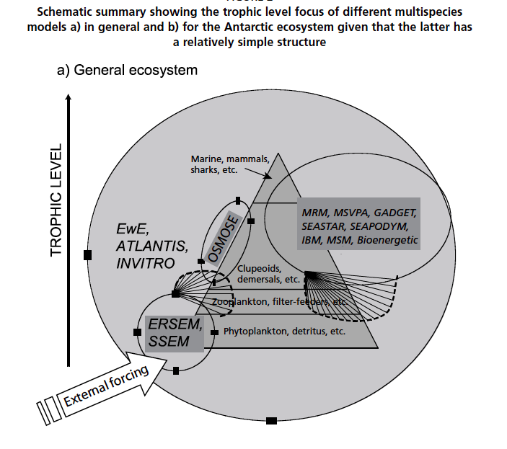
Plagányi 2007

Slide 67
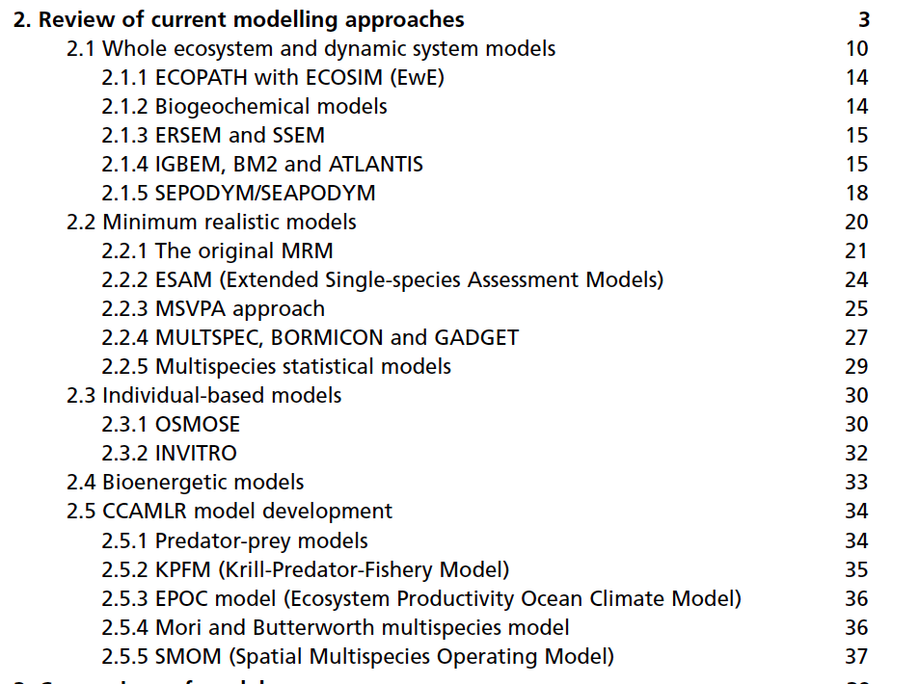
Ecosystem modeling approaches (Plagányi 2007)

Slide 68
Ecosystem models we will cover
Tactical Models
Single species
Single species with ecosystem considerations
Multi-species
Aggregate biomass
Strategic & Heuristic Models
Multi-species
Aggregate biomass
Biophysical
Food web
Biogeochemical
Full system

Slide 69
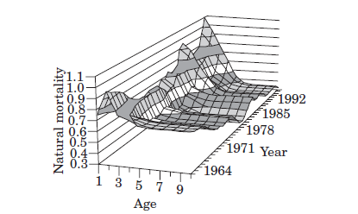
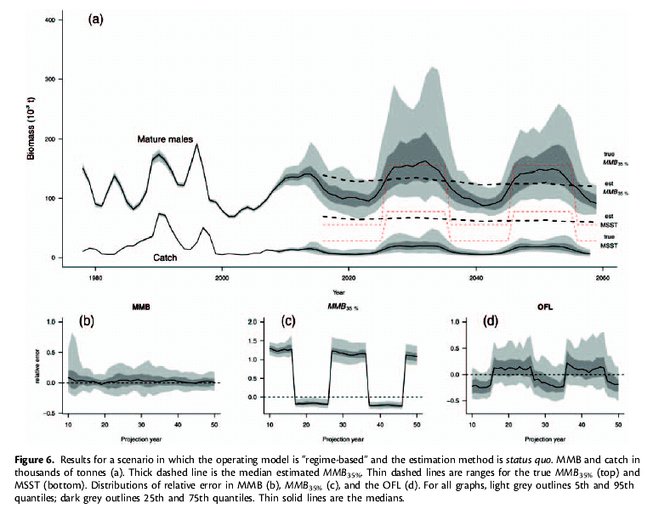
Extended single-species models in fisheries
Intended Purpose:
Assess the status of fish stocks with additional factors added in.
Also known as:
Minimal Realistic Models
Models of Intermediate Complexity
Pros:
Enhanced biological/ecological/ environmental realism
Same model outputs as standard fisheries models
Cons:
Extra data requirements
Harder to insert into management process
Data Needs:
Standard plus stomach or environmental.
Hollowed et al. 2000. ICES J. Mar. Sci. 57: 279–293.
Szuwalski & Punt 2012. ICES J. Mar. Sci. doi:10.1093/icesjms/fss182.

Slide 70
Minimal Realistic Models a.k.a. Models of Intermediate Complexity
Objective of these models is to consider the interactions among a small number of species and components.
Focus on ‘key’ system properties/components relevant to the research or management questions.
May include a suite of model types for each component.
Perhaps statistically estimate model parameters using data similar to single-species models.

Slide 71
Barents Sea Minke Whales-Cod-Capelin EXAMPLE
Several models:
GADGET,
BORMICON,
MULTSPEC, etc.
Explores tradeoffs among 4 main species interactions.
Environment and fishing contrasted.
Bogstad, B., Hauge, K. H., & Ulltang, Ø. (1997). MULTSPEC–a multi-species model for fish and marine mammals in the Barents Sea. Journal of Northwest Atlantic Fishery Science, 22(317-341), 1-1.

Slide 72
Multivariate autoregressive (MAR) models
Take the form
B matrix can be VERY big
Simplified dynamics
Estimating parameters is often non-trivial
BUT, statistical machinery exists.
e.g. Ives et al. 2003 Ecol. Monographs, Holmes et al. 2012. R journal.

Slide 73
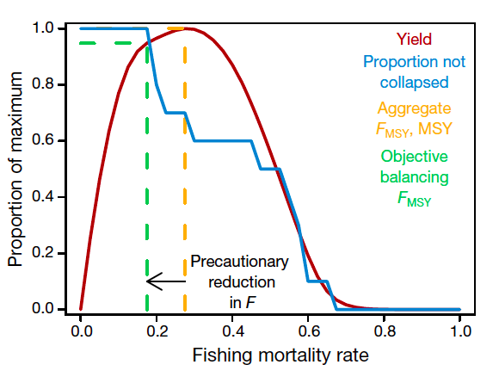
Aggregate Biomass Models in Fisheries
Intended Purpose:
Assess the status of resources as major groups (e.g. guilds, taxa), not as individual stocks.
Pros:
Establishes ability to address trade-offs among fisheries.
Model outputs are still in familiar, albeit aggregated, form.
Cons:
Minimizes stock-specific information
Assumptions of amalgamated vital rate parameters across groups of diverse species & life histories.
Data Needs:
Biomass and catch data, maybe some stomach, but clustered.
Some flows among groups
Gaichas, S., Gamble, R., Fogarty, M., Benoît, H., Essington, T., Fu, C., ... & Link, J. (2012). Assembly rules for aggregate-species production models: simulations in support of management strategy evaluation. Marine Ecology Progress Series, 459, 275-292.

Slide 74
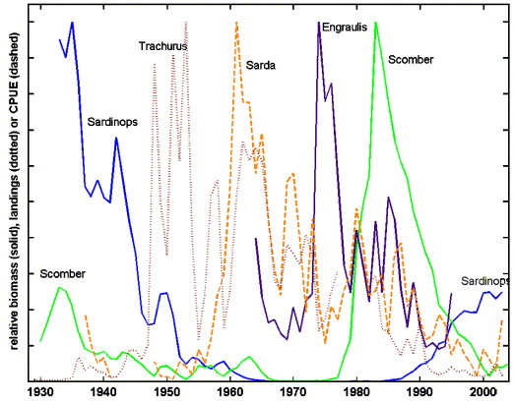
Motivation is that functional groups stable over time despite species mix changing
Field and Francis 2006

Slide 75
Aggregate surplus production models
Uses existing tools, produces typical management advice: but for groups of species
Instead of B being for a particular population, consider the biomass of an aggregated group.

Slide 76
Use of major ecological models used in fisheries
Tactical Models
Single species
Single species with ecosystem considerations
Multi-species
Aggregate biomass
Strategic & Heuristic Models
Multi-species
Aggregate biomass
Biophysical
Food web
Biogeochemical
Full system

Slide 77
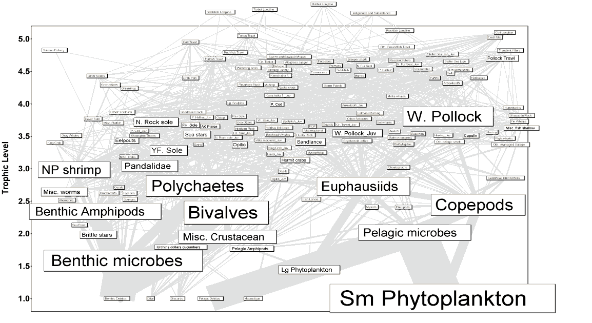
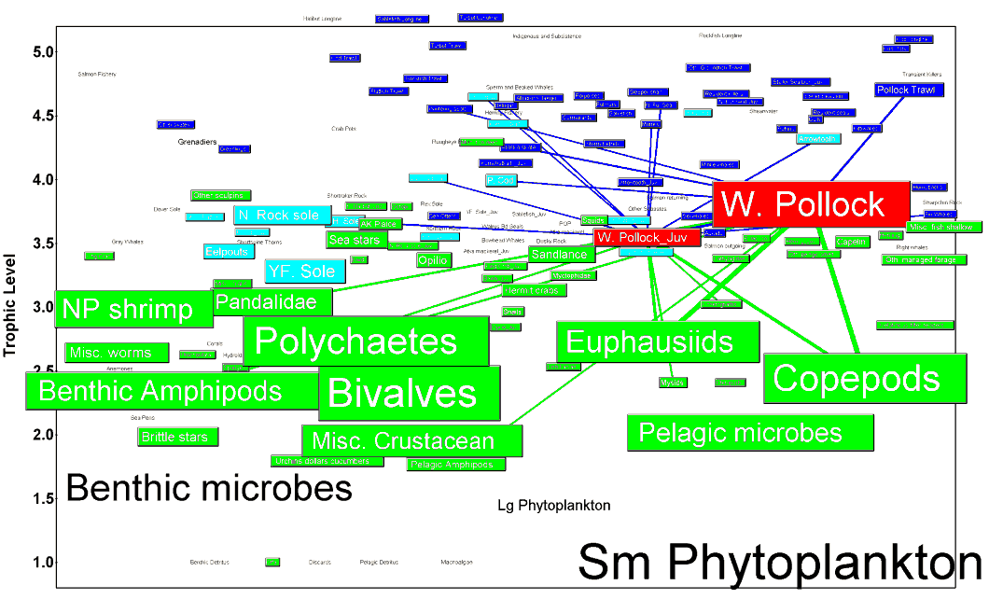
Food web models in Fisheries
Intended Purpose:
Evaluate species interactions, energy flows, and network structure of system surrounding fishery stocks
Pros:
Enhanced ecological realism
Establishes ability to address trade-offs among fisheries
Often serves as a catalog for future work
Cons:
Transparency of models
Assumptions of functional forms
Model outputs atypical for historical fisheries context
Data Needs:
Standard plus stomach, many vital rates, many more taxa than just targeted species
Flows among compartments and rates within compartments

Slide 78
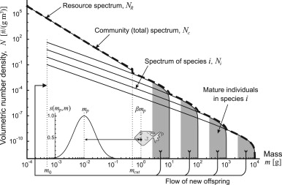
Size spectra models
Simple metabolic models.
Feeding ecology based on theoretical size-based relationships
Focus on size distribution of communities rather than individual species.
Model evaluation by changes to the slopes of the size spectra.
Hartvig et al. 2011

Slide 79
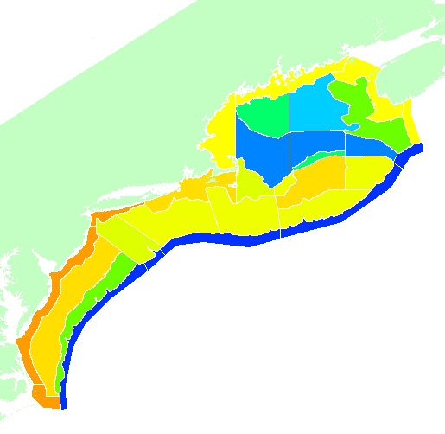
Whole-of-system models in fisheries
Intended Purpose:
Evaluate fish in context of all the potential uses of an ecosystem
Pros:
Inclusive of effectively every possible factor that can influence fish stocks
Excellent for strategic, multiple sector management
Cons:
Models quickly become unwieldy
Multiple functional forms to choose from
Model outputs may or may not be familiar
Data Needs:
Standard plus stomach, many vital rates, many more taxa groups than just targeted species
Flows among compartments and rates within compartments
Economic, socioeconomic and governance drivers
Pelagic
0
50
120+
300+
Epibenthic
Sediment

Slide 80
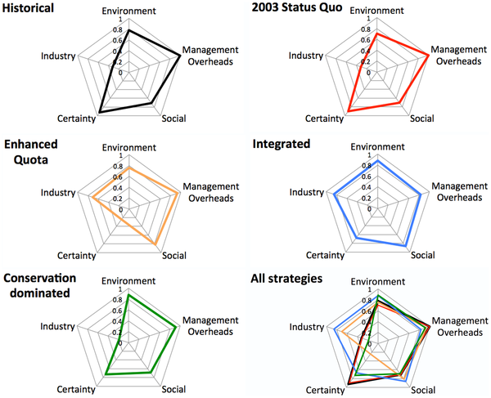
End to end models allow for evaluation of tradeoffs across broader suite of objectives at system level.
Fulton EA, Smith ADM, Smith DC, Johnson P (2014) An Integrated Approach Is Needed for Ecosystem Based Fisheries Management: Insights from Ecosystem-Level Management Strategy Evaluation. PLoS ONE 9(1): e84242. doi:10.1371/journal.pone.0084242
http://127.0.0.1:8081/plosone/article?id=info:doi/10.1371/journal.pone.0084242

Slide 81
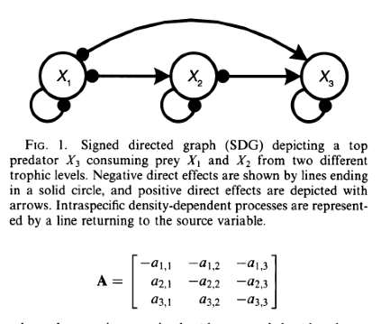
Qualitative models (e.g. loop analysis)
Intended Purpose
Characterize interactions
Assess qualitative responses
General expectations
Pros
Simple to evaluate multiple model structures
Rapid method of determining importance
Easy to understand
Cons
Hard to assign weights to links
Assume linear relationships
Hosack et al. 2008, Ecol. Appl.

Slide 82
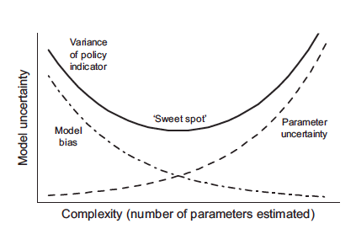
Challenges of ecosystem models: finding the sweet spot
Tradeoff in bias vs. estimation uncertainty
Collie et al. 2014. Fish & Fisheries
Notes:
A schematic view of the way in which model bias declines and parameter uncertainty increases with increasing model complexity. Model bias is related to model fit, as measured by the residual error variance. If the number of parameters is too large, a statistical model will ‘fit the noise’ and can give biased predictions.
Parameter uncertainty is measured by the variance-covariance matrix of the parameter estimates. The variance of key policy indicators is the product of these two sources of error and therefore has a minimum at an intermediate level of complexity (adapted from Walters 1986).

Slide 83
Handling uncertainty in ecosystem models
Problems with classical treatment of parameter uncertainty
Ecosystem models typically have many more parameters than single-species models
High-dimensional parameter space
Can be computationally expensive
Structural uncertainty
How to link system components
What functional forms to choose for relationships
Which system components to choose?
Now mostly being addressed through multimodel inference / ensemble modeling

Slide 84
Additional models: EBM and spatial management
Much of the work on marine EBM has taken the form of regional spatial planning.
Marine Spatial Planning and Ecosystem Service Valuation often involve creating maps.
GIS software often at the core of these exercises.

Slide 85
Evaluating cumulative impacts Spatial mapping, then weighting of ‘footprint’
Halpern et al. (2009) Cons. Lett.

Slide 86
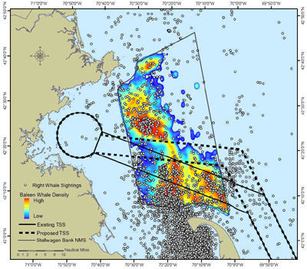
Right whales in Massachusetts, shipping lanes
Risk analysis of ship-strike to whales using maps of whale sightings, habitats, human uses and information on whale feeding ecology.
Shifted shipping lane to reduce ship-strikes.
(NOAA Office of Protected Resources)

Slide 87
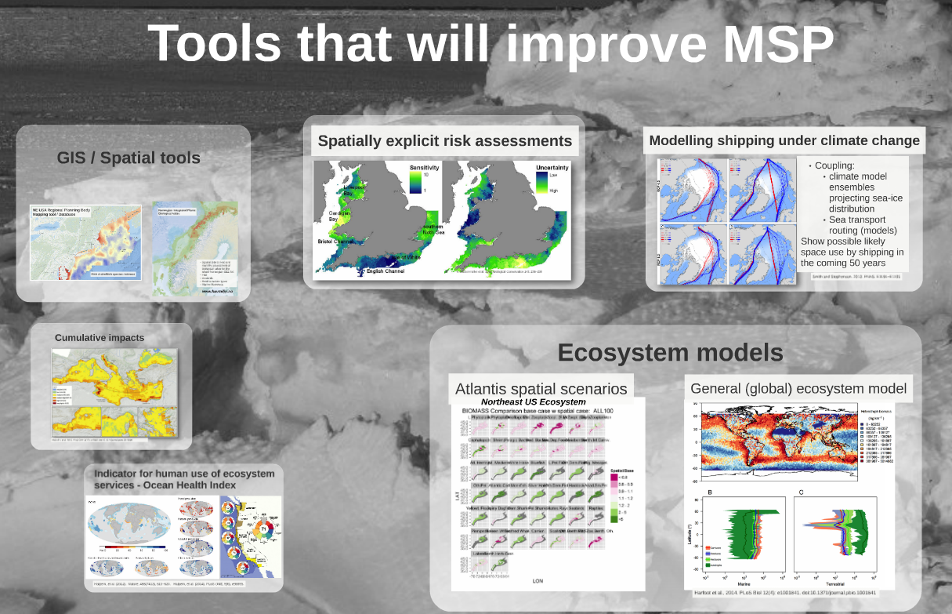
hr

Slide 88
Weaknesses of ecosystem models
Large data demands
Documentation of models is daunting
Challenging to use
Experience and training needed both building and using
Nonstationarity

Slide 89
Key takeaways
There are LOTS of models out there.
For EBM, models can be used to:
Assess ecosystem status
Understand ecosystem function / behavior
Risk analysis
Evaluate performance of management options.
Quantify tradeoffs among sectors / objectives
There is generally no one “right” model to use, multi-model inference is a hot topic and probably preferable.
Adaptive management emphasizes a flexible approach to implementation.

Slide 90
Fisheries and Ecosystem Models
Questions?

Slide 91
Next time on Models for Marine EBM….
Including ecosystem processes in stock assessment models
Environment in stock-recruit models
Modeling predators as a fishery
Time-varying parameters in age-structured models

